Slide 1
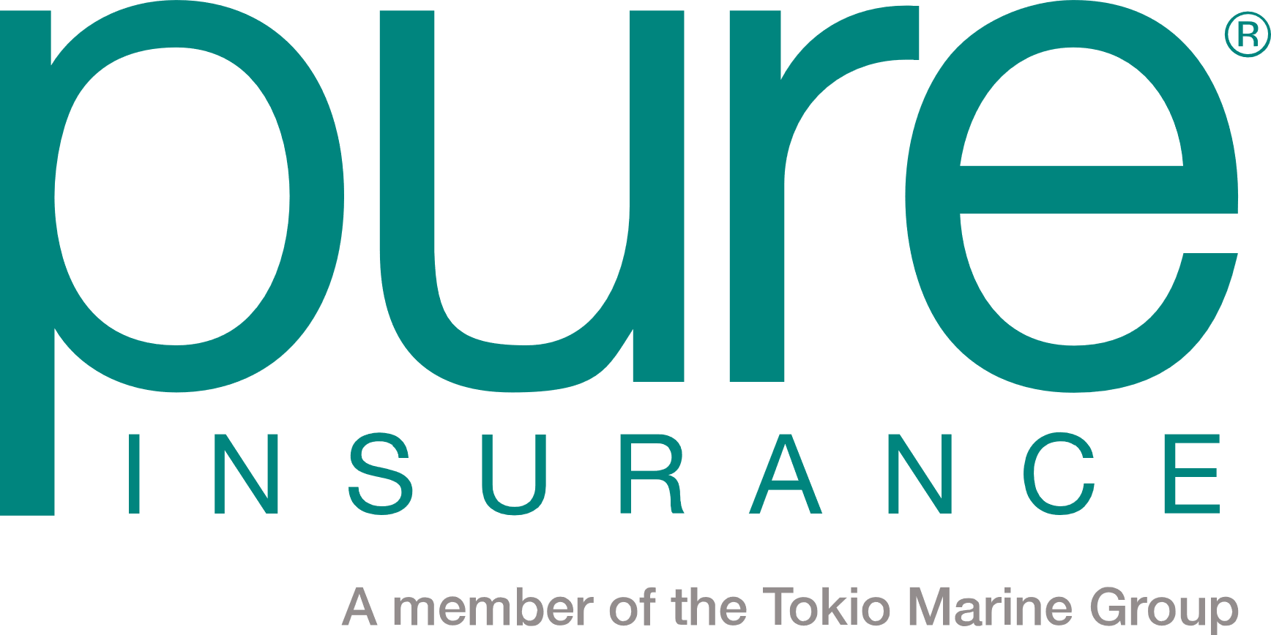
PURE
CHRISTINA CLARK
AVP, National Broker Management
cpclark@pureinsurance.com
407.840.9206

Slide 2
Welcome!
AssuredPartners

Slide 3
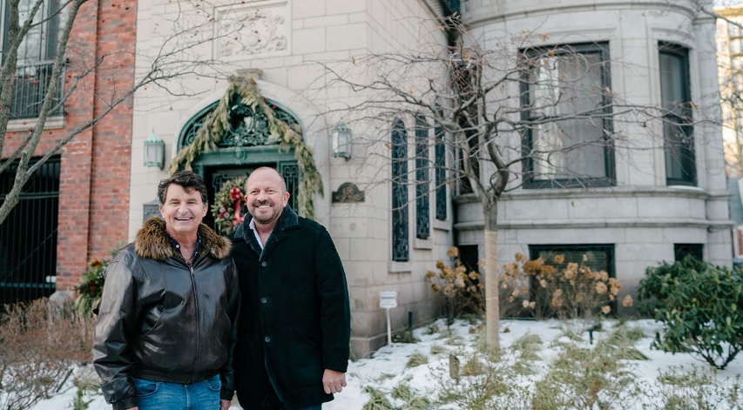
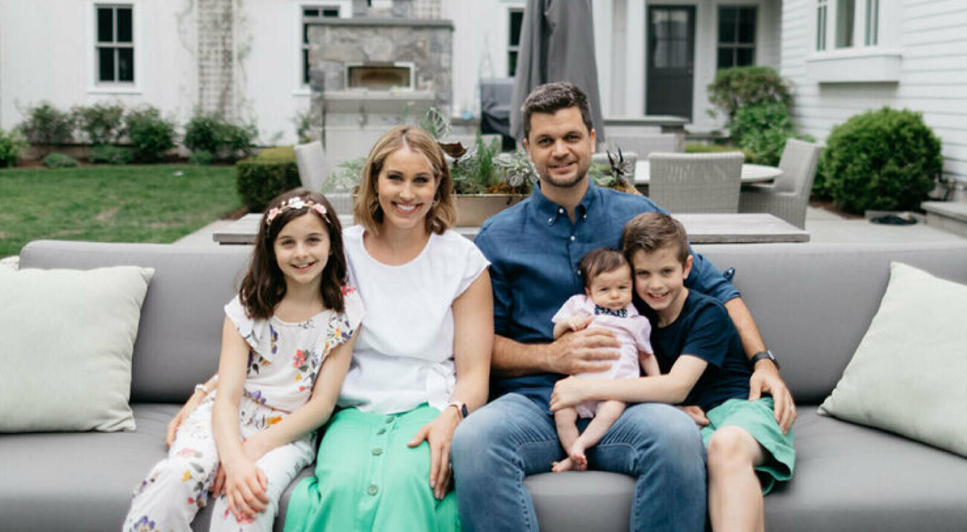
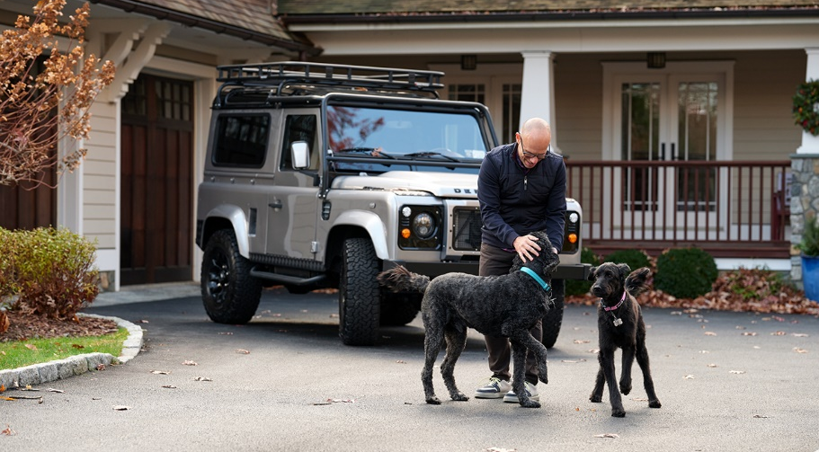
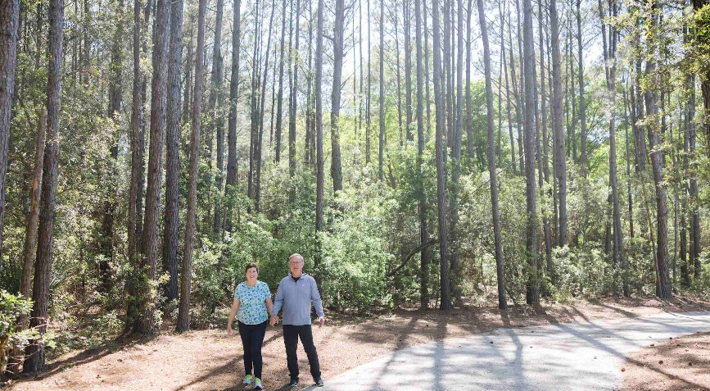
Love Your Insurance
Notes:
As brokers, you’re in a unique position to offer your clients more than just the default option. You can offer them a choice. You can offer them better coverage, faster closings, and in many cases, more competitive pricing. And at PURE our mission statement is LOVE YOUR INSURANCE, and this means we are focused on creating a membership experience so compelling that our members never want to leave, and so for us, private flood was a product we took time to thoughtfully craft.
PURE Private flood insurance gives you:
Higher coverage limits
Broader protection
Shorter or no waiting periods
Underwriting flexibility
And coverage for a single flood event
And a chance to differentiate yourself in a crowded market. So let’s take a look at how our private flood solution stacks up.

Slide 4
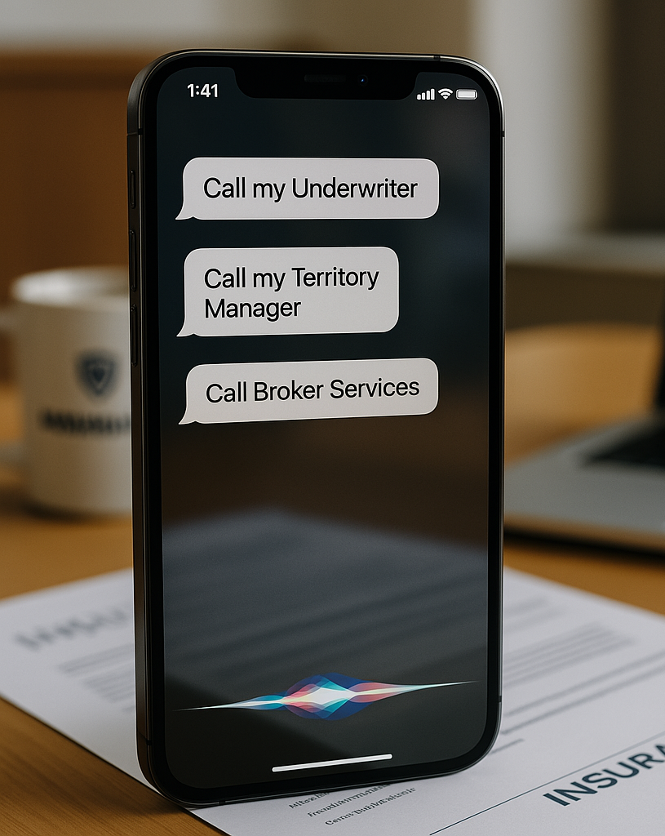


Ask us about our…
Pure and Pure Programs Flood Launch
Coming in September

Slide 5
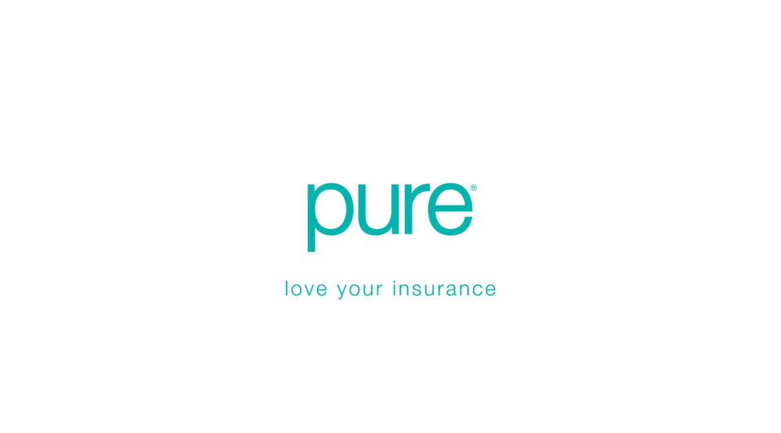

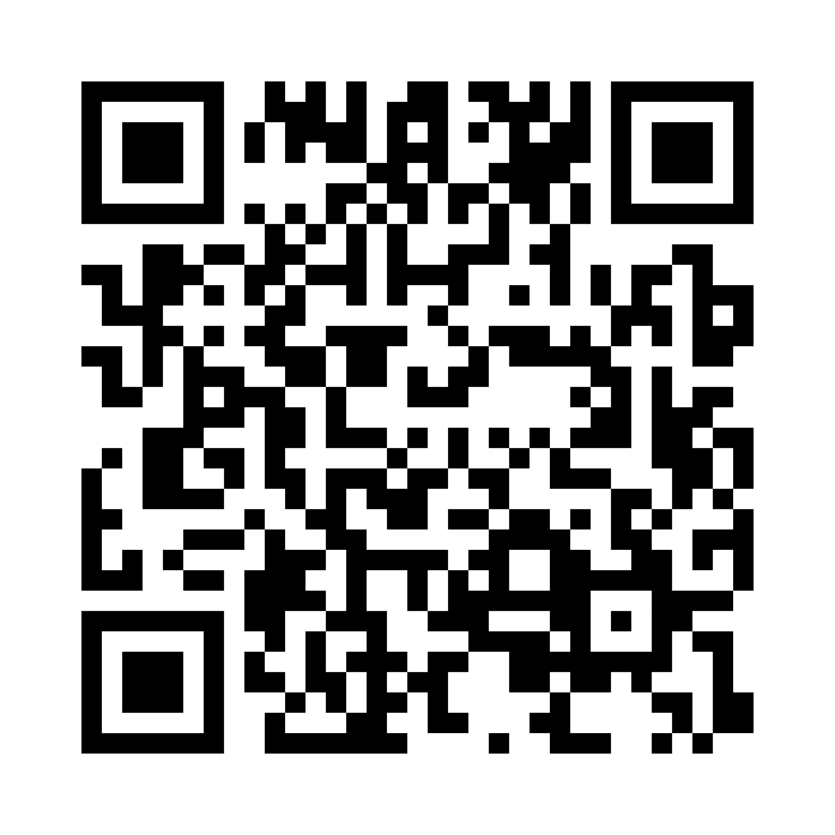

Delivering Greater Value
https://www.pureinsurance.com/newsroom/delivering-greater-value
Notes:
https://www.pureinsurance.com/newsroom/delivering-greater-value

