Slide 1
TRANSPORTATION:
MOVING WITH CONFIDENCE
ANDY ENGARDIO

Slide 2

Niches Within
Our Vertical
  Trucking
  Warehousing
  Distributors
  Gig Economy
  Livery/ Passenger
  Last Mile
  Moving & Storage
  Towing
  Ambulance
  Non-Emergency Medical
  Freight Forwarding and Freight Brokerage

Slide 3
Direct Insurance Carrier
Great West
Sentry
National Interstate
Lancer
Great American
Vanliner
Acuity
Progressive Fleet
Progressive
Geico
DMC
Hudson
Carolina Casualty
AmTrust
Cincinnati Insurance
CAN
CoverWhale
RLI
Allianz
Travelers
Loadsure
American Inter-Fedelity
Applied Underwriters
Auto Owners
Avant
Berkshire Hathaway
Blue Ridge Specialty
Central Mutual
Cherokee
Falvey
EMC
Hartford
Hanover
IAT
Intact
Nationwide AG
Nirvana
HDVI
Pekin
Third Coast
Transguard
US Marine
West Bend
And more…

Slide 4

Organize the Engines
Sales Committee
Objective: Increase Transportation Sales
Open Projects
Regionalize expertise under mentors
Increase recruitment into APT offices
Establish best practices to develop APT producers
Run monthly marketing meetings
Roll out accretive APT portfolio
SL
SC
Steering Committee
Objective: Grow the Transportation Books
Completed Projects
Education course: MCIEF
Identifying transportation producers/offices
Deepen carrier relationships
Open Projects
Gather and review total transportation book
Identify opportunities for growth
  Accretive
  Captive
Oversee direction of operations committee
  And sales / mentor committee
Operations Committee
Objective: Set and Improve Service Standards
Open Projects
Standardize workflow for all
APT Offices / Service Teams
Agree upon a universal products and
implementation (RFP, Proposal; etc)
Ops
RMSC
Packaged Solutions
Objective: Provide Single Site Enhanced Services
Open Projects
APT TaskForce and ResourcePro
Samba MVR master contract
Loss control services

Slide 5




National Memberships

Slide 6
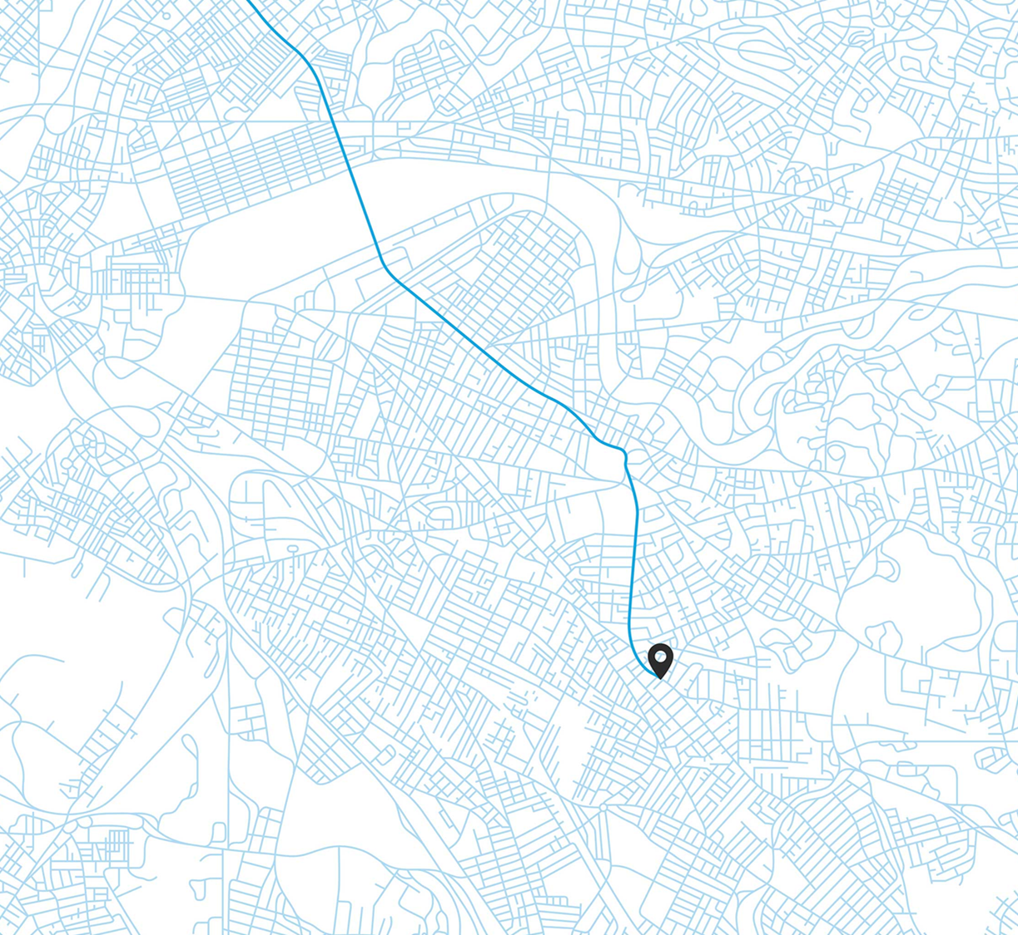
Getting Our Best Rate with our Telematics Programs
Increase conversion and retention by adding one of our telematics programs to your policies
ProView
Smart Haul
Commercial Vehicles that do not require an ELD. (Everyone else)
Commercial Vehicles requiring an Electronic Logging Device (ELD)
Automatically offered on all fleet quotes.
6
Notes:
TRAVIS SLIDE

Slide 7





Business Market Targets (BMTs)
ProView (if not eligible for Smart Haul)
Smart Haul
BUSINESS AUTO & CONTRACTOR PROGRAMS |  |  |  | HEAVY TRUCK PROGRAMS
BUSINESS AUTO PROGRAM Broad variety of vehicle types used in many industries |  | CONTRACTOR PROGRAM Vehicles used in contractor businesses |  | FOR-HIRE TRANSPORTATION PROGRAM Freight trucks that haul goods for others | FOR-HIRE SPECIALTY TRUCK PROGRAM Work trucks focused on specific niches or hauling for others | TOW PROGRAM Tow trucks with hooks (wreckers) and rollbacks (car carriers)
Consultants Janitorial services Retail shops Religious/nonprofit organizations Farming & livestock | Couriers Wholesale distributors Food truck vendors/delivery For-hire livery … & more | Contractors Carpenters Plumbers Electricians Landscapers Snowplowers | Heavy construction Concrete & asphalt Construction General trades … & more | Owner-operators Expeditors General freight haulers Agriculture hauling Household movers Tractor-trailers … & more | Dirt, sand & gravel haulers Log haulers Garbage, waste & debris haulers Tractor-trailers Coal haulers … & more | Tow services Gas stations Auto repair shops Anytime roadside assistance … & more
Vehicles
Businesses
7

Slide 8
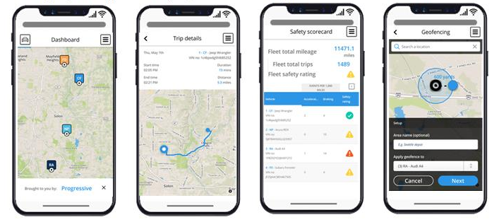

Snapshot ProView
®
Real Time Tracking
Trip Details
Safety Scorecards
Geofencing
Discounts of 5%-20%
8
Notes:
TRAVIS SLIDE
* What is Proview?
* Why do small businesses NEED telematics?
And there’s a savings piece? Similar to snapshot, but for business customers…
Todos los clientes reciven un descuento de 5-20%.
clientes con 1 a 2 vehiculos reciven un reporte mensual de la historia de conducir per vehiculo.
Clientes de 3 or mas vehiclues receive accesso a un tablero de seguridad donde el cliente puede:
Localizar sus vehiculos
Obtoner information de viajes por vehiculo
Reporte de historia del conductor - una Buena herramienta para entrenar los choferes de cado carro
Notificaciones geocerca da alerta cuendo el vehiculo sale de la area.

Slide 9



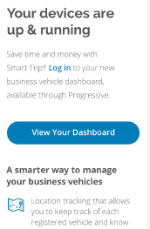
Getting Started Is Easy
1.
2.
3.
Quote
Install
Register
Agent quotes on ForAgentsOnly.com
We mail device(s) and customer installs
After installation, customers with any number of power units register for our Proview Dashboard to track and manage their vehicles
9
Notes:
TRAVIS SLIDE
For step 1, FAO questions includes agent and customer emails
Pilot phase: OH and PA: 5% savings; CT, GA, MA, NC: agent incentive
Very streamlined process.

Slide 10
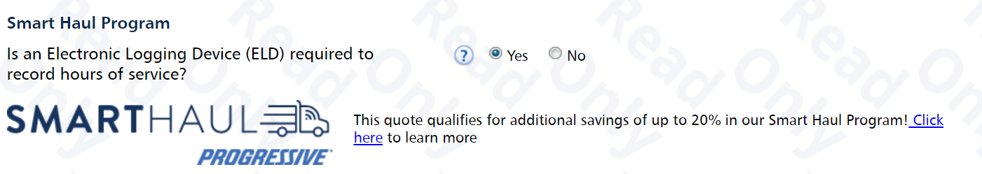
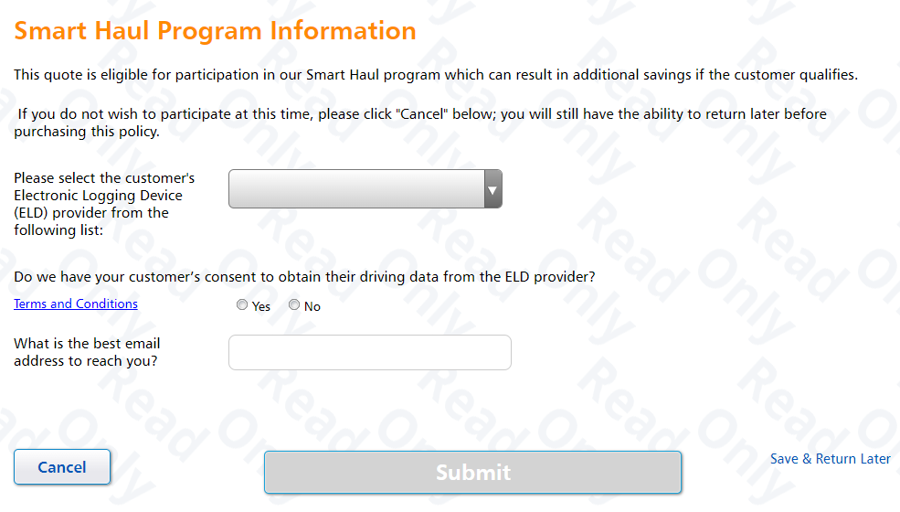
Getting Started Is Easy
Answer yes to the question
“Is the customer required to maintain hours of services records using an ELD?”
Complete the Smart Haul enrollment form.
Automatic 3-5% savings
Partnered companies could get up to 30% applied savings to the quote w/in 24 hrs. (Geotab, Motive and Omnitracs)
10
Notes:
TRAVIS SLIDE
Enrolling in smart haul is simple!

