Slide 1
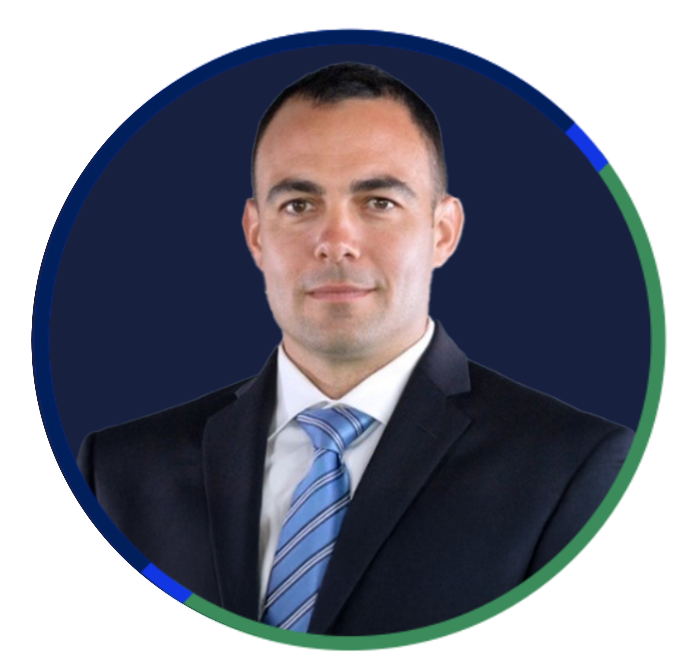



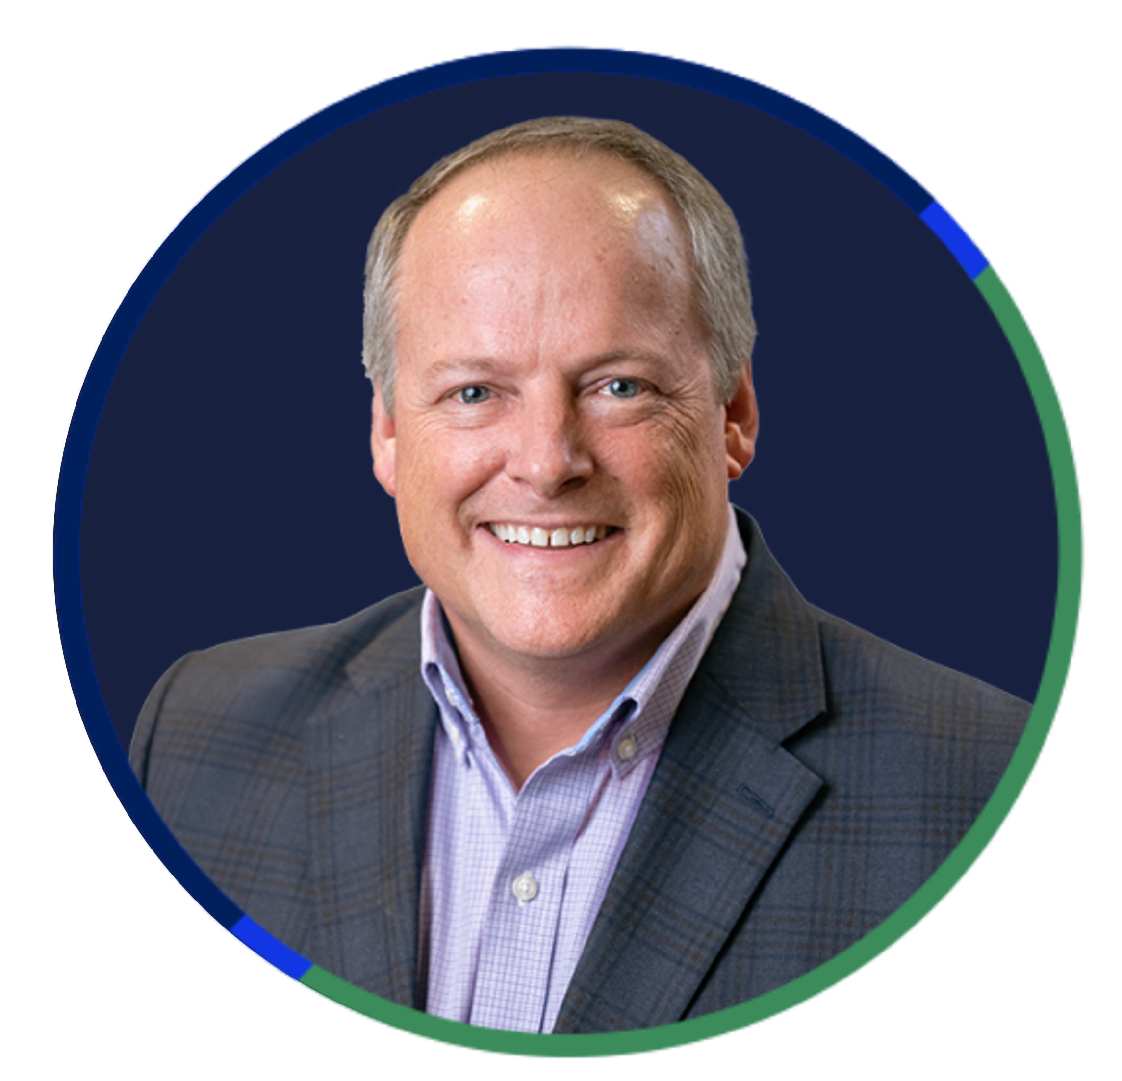


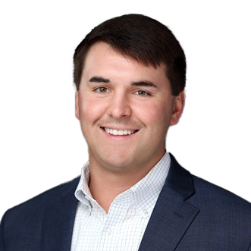
FUELING THE WIN
Vertical Cross-Selling & Success Stories
Alush Garzon
National Manufacturing Vertical Leader
Trevor Gilstrap
National Energy Vertical Leader
Eric Stevens
National Real Estate Vertical Leader
Gina Ekstam
National Agribusiness Vertical Leader
Eric Barfield
National Aerospace Vertical Leader
Amy Mitchell
Vice President Commercial Solutions
Chad DeBona
Senior Sales Executive, Commercial Lines
Ed Williams
Commercial Lines Advisor

