Slide 1

LIBERTY/SAFECO
LINEL PEREZ
AVP, National Relationship Executive
Linel.Perez@LibertyMutual.com
469.997.6551

Slide 2

Personal lines
Safeco | Gold

Slide 3
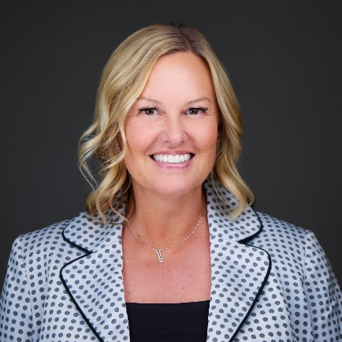
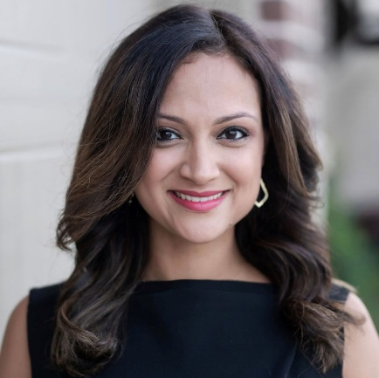
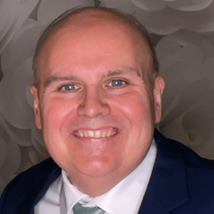

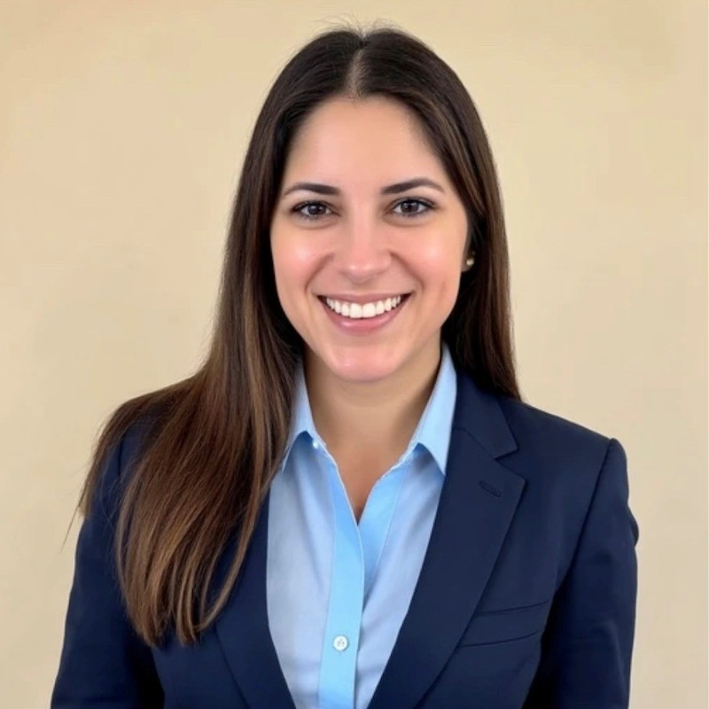
Your Safeco & Liberty Mutual team here today!
Meet our team at Partner Connect 2025!
Liberty Mutual Team & Business Units
U.S. Retail Markets
Personal and Small Commercial
Global Risk Solutions
Midsize, large, and specialty commercial
Carrie Ragle
VP National Agency Management
Linel Perez
AVP National Relationship Executive
Billy Quesenberry
Gold Service Marketing Manager
John Hanshaw
Director, Broker Relations & Operational Performance
Alison Murphy
Middle Market Underwriting Manager

Slide 4
We are committed to
building and updating
our broad product suite
and accelerating investments to deliver new or refreshed products regularly

Slide 5
Gold Service overview

Slide 6









Service
Gold Service CSRs look for every opportunity to connect with Policy Holders and Agencies 24/7/365
Multiple channels to connect
Ways we provide support

Slide 7

Retention
Gold Service CSRs understand the importance of retaining every policy within the agency
  Outbound billing calls
  Policy reviews
  Partnership with agencies
  UW follow up at 60-day mark
  Gold Increases Retention
4.4%

Slide 8


Exclusive Incentive for AP!
Gold Elite pricing for newly enrolled Service Codes!
This information is being delivered to you with the understanding that its use will be limited to the business requirements of your independent agent relationship with the Company and consistent with the confidentiality obligations expected of you by the Company, including those contained in any agreements you have with the Company or applicable under state, federal, or common law. All trademarks are the property of their respective owners. Use of any mark herein does not imply any affiliation with or endorsement by any trademark owner.
Notes:
-

Slide 9
