Slide 1
It’s Me, I Promise – Advances in Social Engineering
Presented to AssuredPartners By:
Jennifer A. Coughlin, Managing Member – Mullen Coughlin LLC
August 13, 2025

Slide 2
Social Engineering
Social engineering is a manipulation technique wherein a fraudster weaponizes trust, fear, or another emotion to convince a victim to perform actions or provide information, currency, or another valuable to the fraudster
Per the FBI, over $1 billion was lost as a result of deceptive, social engineering-like attacks
Fraudsters are using deep fake audio, and now video, more and more frequently in their social engineering attacks

Slide 3
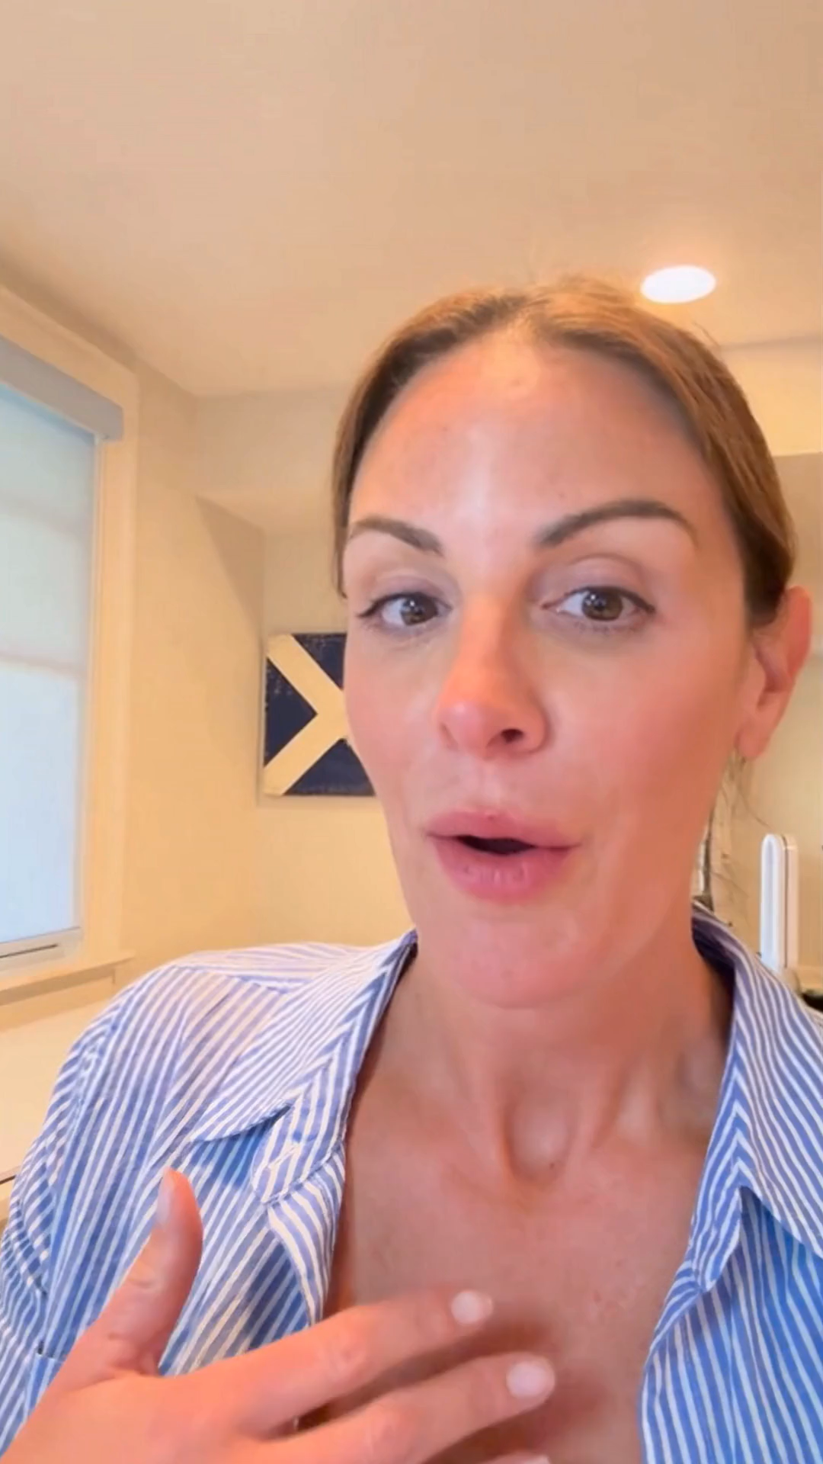
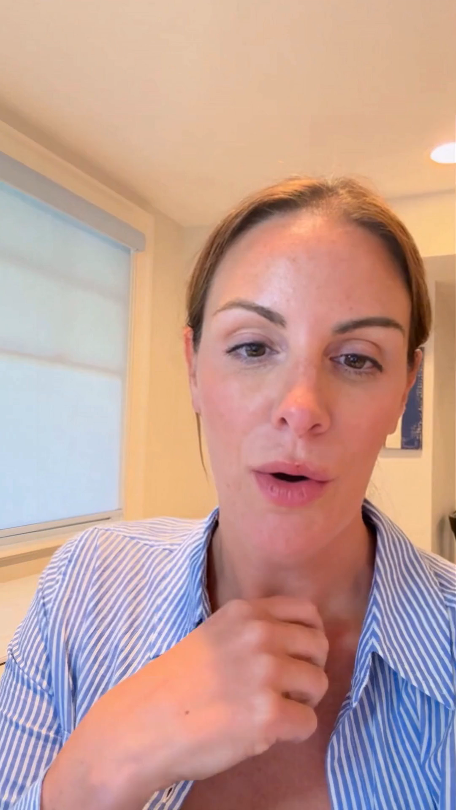

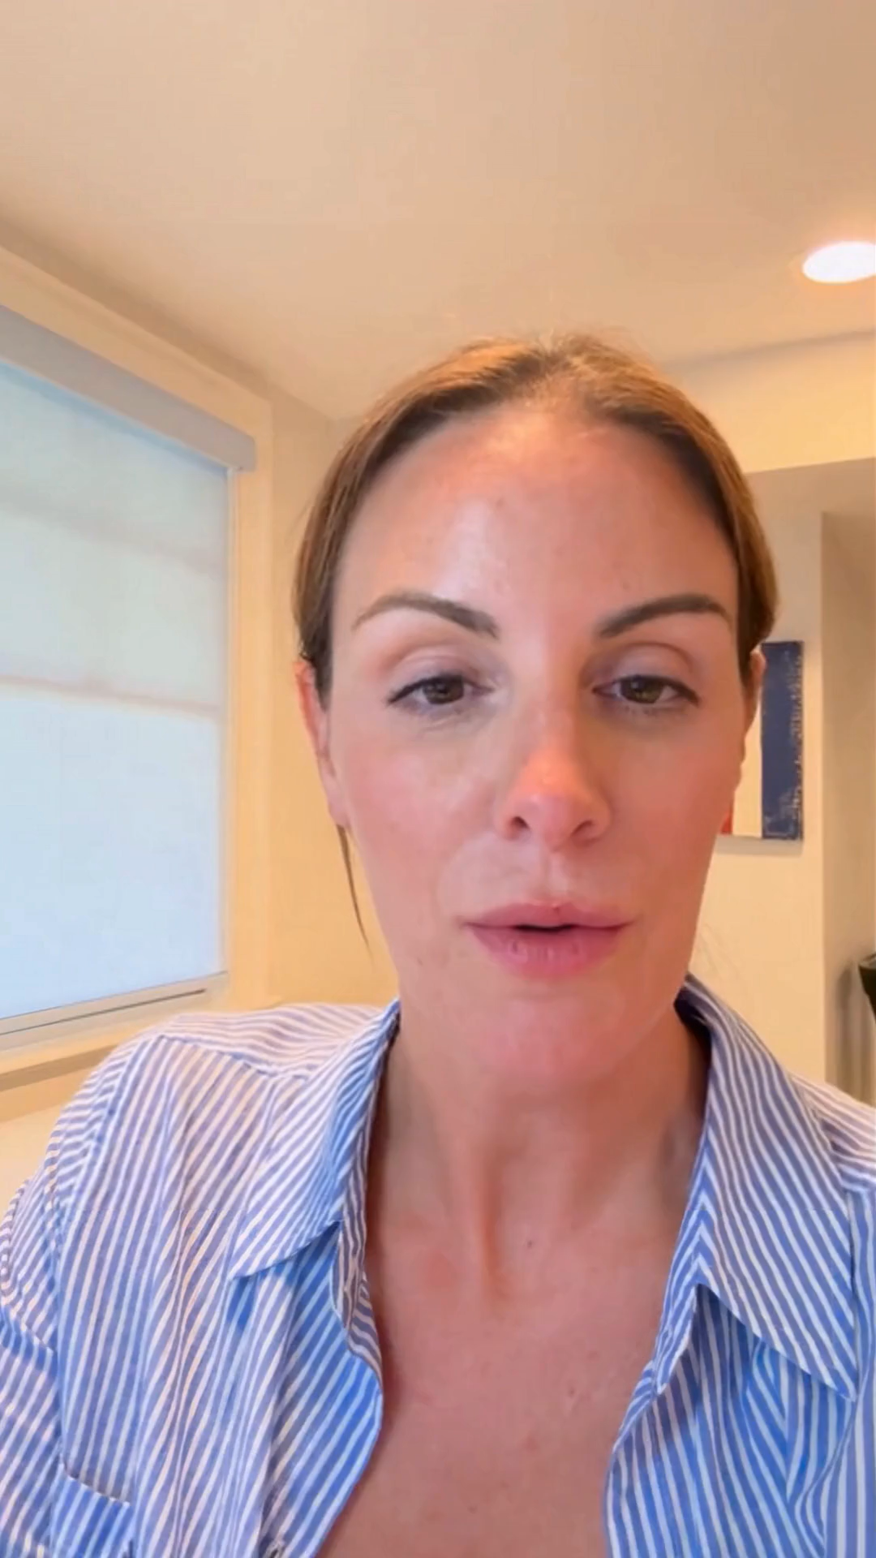
Deep Fakes - Video
Video 1
Video 2
Video 3
Video 4

Slide 4

Deep Fakes - Audio
Audio 1
Audio 2
Audio 3

Slide 5

Contact Information
Jennifer A. Coughlin
Managing Member – Mullen Coughlin LLC
E: jcoughlin@mullen.law | P: 267.930.4774
Mullen Coughlin’s AssuredPartners Hotline
P: 844.717.6186
E: assuredpartners.breachhotline@mullen.law
24/7/365 Incident Response Hotline
844.885.1574 (U.S.) | +44 8085020579 (UK)
MULLEN.LAW | LINKEDIN
426 W. Lancaster Avenue, Suite 200
Devon, PA 19333

Slide 6
This presentation is the property of Mullen Coughlin LLC. It is shared for educational purposes and does not constitute legal advice, nor does it guarantee a specific result or outcome in any matter. The presentation and the information contained therein is current as of the date of this presentation and provided for this limited use by the intended recipient and may not be used, published or redistributed without the written prior consent of Mullen Coughlin LLC. The act of sending e-mail to a presenter, or viewing or downloading information from this presentation, does not create an attorney-client relationship.
© 2025 Mullen Coughlin LLC

