Slide 1
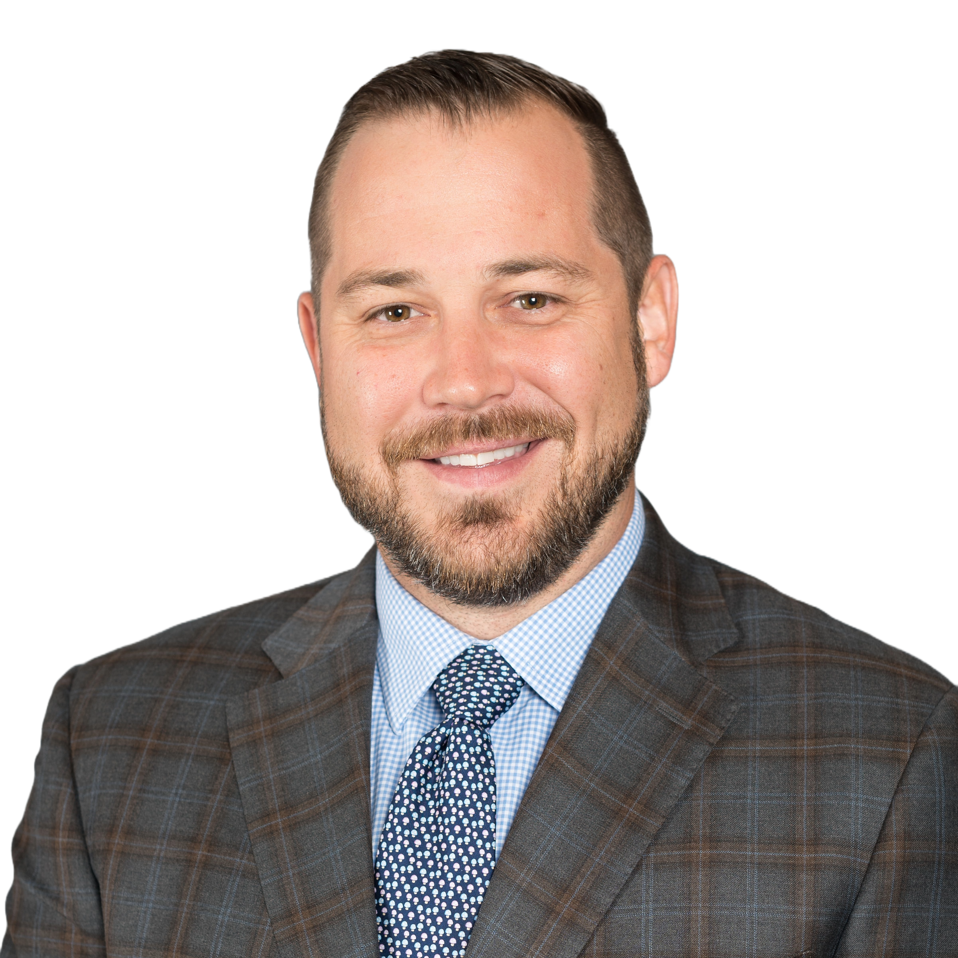
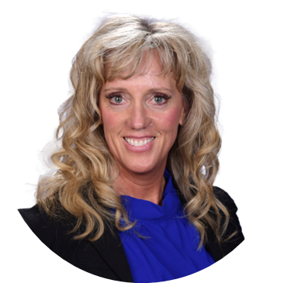

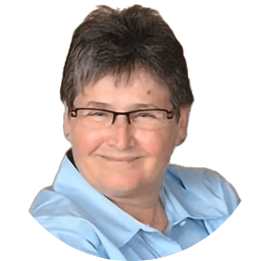
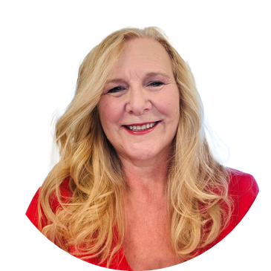
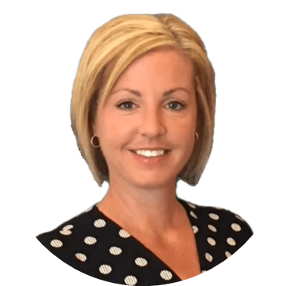
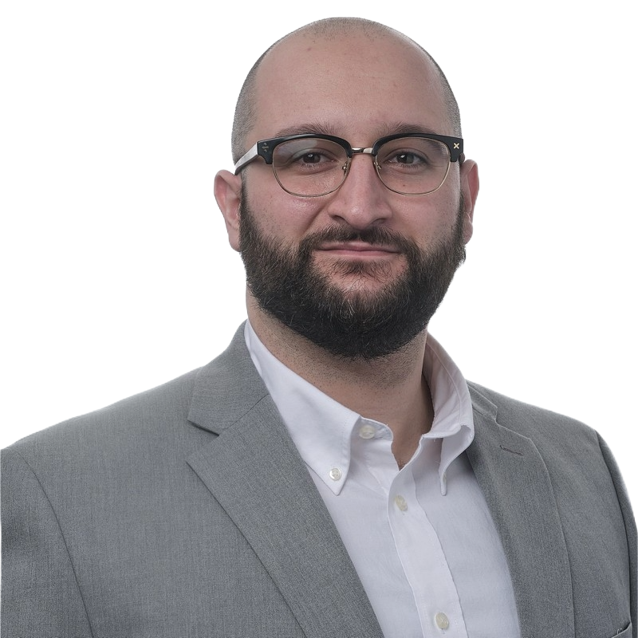
PRECISION ENGINEERING
Risk Management Service Center Solutions
Mike Randall
EVP, Vertical Strategies
Tara Crisp
Director of Risk Management
Brian McNulty
Senior Risk Management Advisor
Patti Gander
Sr. Manufacturing Consultant & Loss Prevention Specialist
Leanne Ingwersen
Risk Manager
Kristy James
Healthcare Vertical Litigation & Clinical Leader
Sayf Al-Ani
Senior Risk Analyst

