Slide 1
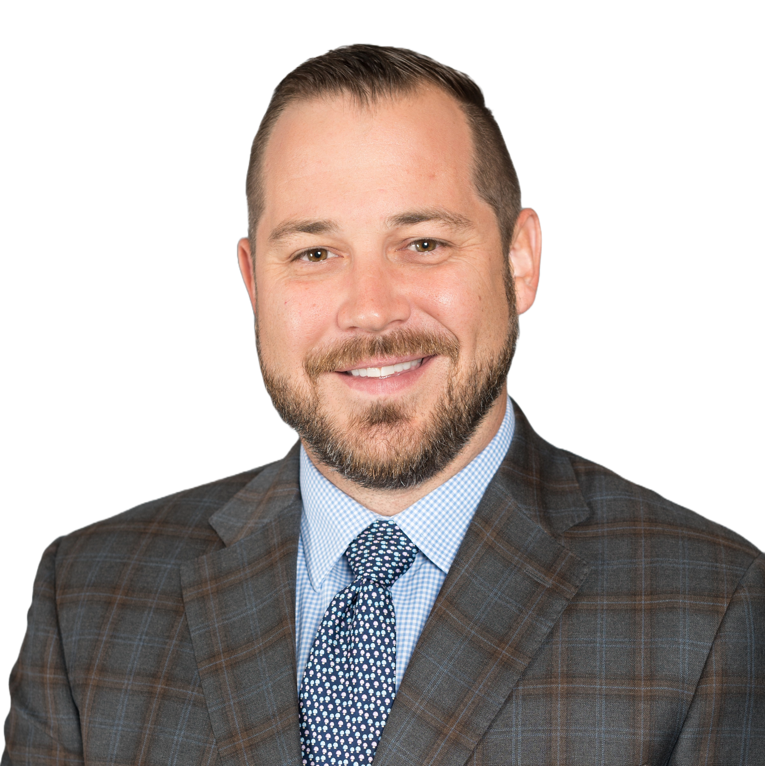

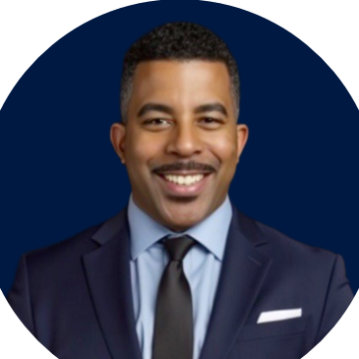
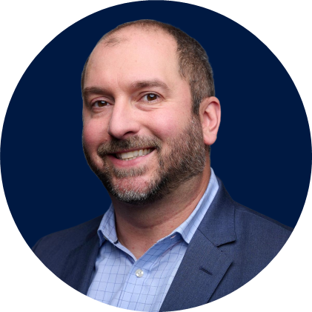
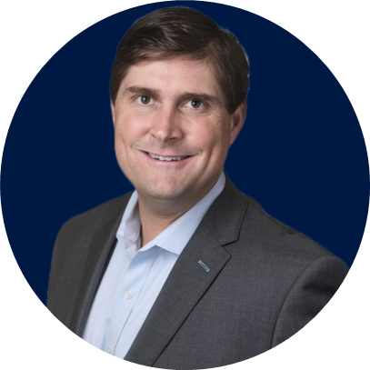
CLIENT CONNECTION LANE
Unlocking Resources That Drive Value
Mike Randall
EVP, Vertical Strategies
Rob Roth
Executive VP, Operations Accretive
Anthony
Robinson
Regional VP,
EVHC
Nick Tuliebitz
Co-Head of M&A Insurance –
North America
Taylor Boon
National GovCon Vertical Leader + CEO
The Boon Group

