Slide 1
MANUFACTURING:
ENGINEERED FOR RISK
ALUSH GARZON, PATTI GANDER,
WOLFGANG NEUWIRTH

Slide 2
Services Overview
  CLAIM REPORTING & MANAGEMENT
  INDUSTRY SPECIFIC RISK ASSESSMENT
  OSHA​
      Facilitate communication among all parties​
      Negotiate and manage claims reserves​
      Bring outstanding claims to closure​
      Assist with aggravated inequities​
      Work comp stewardship report​
      Return-to-work assistance​
      Periodic claims reviews
      Facility tours​
      Employee / management interviews​
      Manufacturing risk overview assessment​
      Comprehensive business assessment​
      Comprehensive feedback report​
      Disaster recovery / business continuity
      OSHA consulting services​
      Mock audits​
      Written complaint responses​
      Accompany OSHA inspectors on a facility tour​
      OSHA response action plan​
  EMPLOYEE BENEFITS​
  SAFETY​
  WORK COMP DATA
      Brokerage services​
      Financial services​
      Executive benefits​
      Consulting and analytics​
      Compliance​
      Manager and employee safety training​
      Safety committee development​
      Carrier loss control assistance​
      Safety manual writing​
      Accident investigation​
      Employee surveys
      Promulgate and verify experience modification factors​
      Cost of injuries analysis​
      Analyze trends and overall financial impact​
      Actuarially predict future loss projections​
      Assist with collateral requirements negotiations​
      Alternative risk financing feasibility study​
  ADDITIONAL SERVICES​
      Policy review​
      Contract review​
      Alternative funding feasibility study​
      Benchmarking​
  CARRIER RELATIONSHIPS​
  E-SERVICES​
      Marketing with national manufacturing carriers​
      Specialty manufacturing programs​
      Vertical support from all national carriers​
      Veryable’s on-demand labor solutions​
      Quarterly industry update​
      RMC access​
      Mineral access​

Slide 3
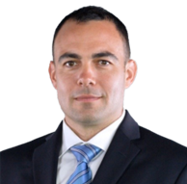
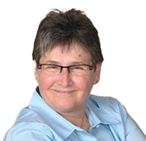
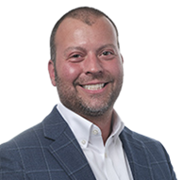
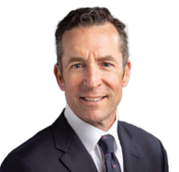
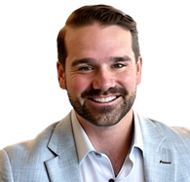
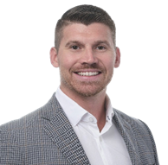
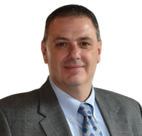
Leadership Team
Alush Garzon
National Manufacturing Vertical Leader
alush.garzon@assuredpartners.com
813-867-2994
Patti Gander
Sr. Manufacturing Consultant &
Loss Prevention Specialist
patti.gander@assuredpartners.com
813-658-2139
Jack Carra
Advisory Council Member
Sr. Vice President - Great Plains Region
jack.carra@assuredpartners.com
515-778-3689
Paul Mattes
Advisory Council Member
Vice President - Great Lakes Region
paul.mattes@assuredpartners.com
586-822-7380
Chad DeBona
Advisory Council Member
Commercial Lines Advisor - Mid Atlantic Region
chad.debona@assuredpartners.com
570-498-9027
Blake Ayers
Advisory Council Member
Agency President - Midwest Region
blake.ayers@assuredpartners.com
270-393-6296
Jim Schmidt
Advisory Council Member
Sales Leader
jim.schmidt@assuredpartners.com
805-585-6757

Slide 4
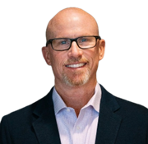
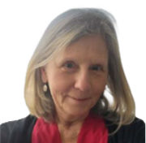
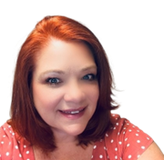
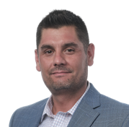
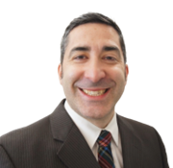
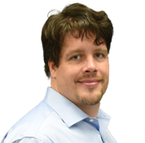
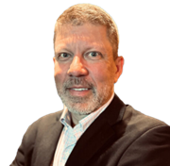
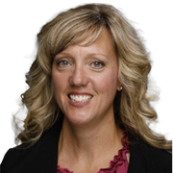
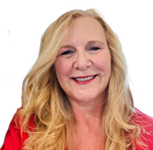
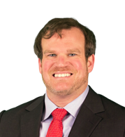
Service & Support Team
Joe Hindman
Account Executive
Becky Shinn
Account Manager
Naomi McCullock
Marketing Manager
Tyler Haldane
Data Analyst
Angel Berrocal
Claims Consultant
John Glover
Claims Consultant
Jeff Kurz
Alternative Funding
Tara Crisp-Schwartz
OSHA Consultant
Leanne Ingwersen
Technology Consultant
Justin Schneider Contract Reviews

