Slide 1
EDUCATION:
EDUCATED RISKS
SAM DAUME, BRIAN HUGHES, BOBBY RILEY

Slide 2
Services Overview
  CLAIMS ADVOCACY & MANAGEMENT
  RISK MITIGATION​
  ADDITIONAL SERVICES​
      Adverse Event Mitigation via “Quick Response”​
        Litigation and Regulatory Concerns Triage​
        Root Cause Analysis​
        Crisis Management​
      Report to Insurance Carrier​
      Claim Resolution Strategy​
      Panel Counsel Review​
      Legacy Claims Management
      Customized Risk Management Service Plans​
      Risk Assessments and ERM Projects​
      Extensive Risk Management Library ​
      Facilitate Tabletops​
      In House Outdoor/Experiential Education Consultant ​
      Insurer Resources Coordination and Oversight​
      Coordination of Carrier and AP Resources​
      Account Management and Marketing Support​
      Service Timeline Execution​
      Foreign Travel – Flipped Model​
      In House Cyber Specialist ​
      Deductible, Retention, and Self-Insurance Feasibility Studies​
  INDUSTRY EXPERTISE​
  SERVICE EXCELLENCE​
  EMPLOYEE BENEFITS​
      Industry Specific Risk and Insurance Solutions​
      Active Members/Presenters at Industry Associations​
      Launch, Manage, Grow Consortiums​
      Captive Feasibility Projects
      Education Dedicated Client Managers ​
      Manage Annual Service Cycle​
      Make Renewal Process Easy​
      Proactive; Responsive Risk Management Support
      Brokerage Services​
      Captives​
      Financial Services​
      Executive Benefits​
      Consulting and Analytics​
      Compliance​
  CARRIER RELATIONSHIPS​
  STUDENT BENEFITS​
  DATA ANALYTICS​
      Vertical Support from Carriers​
      #3 Broker with United Educators​
      Policy Review, Underwriting, and Coverage Analysis​
      Student Health Insurance​
      International Student Insurance​
      Intercollegiate Sports Insurance​
      Mandatory Student Accident Insurance​
      Limits and Deductibles Benchmarking Analysis​
      Building Replacement Cost Value Evaluation​
      Property Risk Modeling

Slide 3
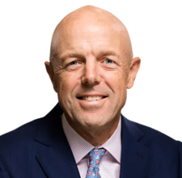
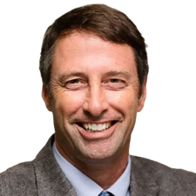
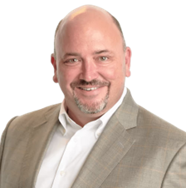

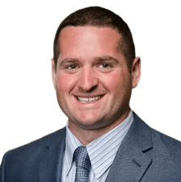
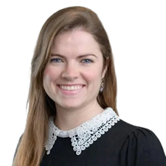
Our Team
  Sam Daume
  National Education Vertical Leader
  978-322-7233
  samuel.daume@assuredpartners.com
  Mike Lucas
  Charter School Practice Leader
  978-322-7211
  mike.lucas@assuredpartners.com
  Brian Hughes
  Higher Education Practice Leader
  515-778-1010
  brian.hughes@assuredpartners.com
  Mark Vermeal
  Outdoor Practice Leader
  978-322-7272
  mark.vermeal@assuredpartners.com
  Bobby Riley
  K-12 Practice Leader
  978-322-7325
  bobby.riley@assuredpartners.com
  Julie Brown
  Service Team Lead
  978-322-7248
  julie.brown@assuredpartners.com

