Slide 1
REAL ESTATE:
HIGH-YIELD COVERAGE
ERIC STEVENS, CHERYL MOULTHROP,
SAYF AL-ANI

Slide 2
10 or 10,000
Locations:
Same amount of Time

Slide 3
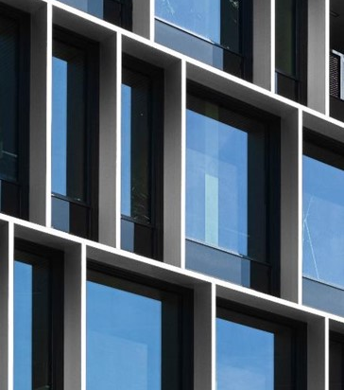
Hazard Probabilities
Distance to Fire Station
Coastal Storm
Crime
Earthquake
Flood Risk
Non-Weather Fire
Non-Weather Water
Wildfire
Tornado (EF0-EF3+)
Hurricane (0.1%-50%+ Loss)
Hail Insight
Hail Risk (0.75-2.00+ inches)

