Slide 1
HEALTHCARE:
PRECISION UNDER PRESSURE
ABBY GOSS, KRISTY JAMES

Slide 2
Services Overview
  DATA ANALYTICS
  SAFETY PROGRAMS & RISK MITIGATION
  Origami Risk Platform
      Incident Intake and Processing
      Real-time/Online Claims Management
      Total Cost of Risk Analysis
      Benchmarking Limits and Deductibles
      Detailed Loss Analysis/Loss Trend Identification
      IMPACT Analytics
      Limit Batching Analysis
      Building Replacement Cost Value Evaluation
      Property Risk Modeling
      Accident Investigation Process
      OSHA Compliance Training
      Policy and Procedure Review
      Return-to-Work Analysis
      Safety Culture Analysis
  CLAIMS ADVOCACY & MANAGEMENT
  CLINICAL RISK MANAGEMENT
      Adverse event mitigation via “Quick Response”
        Litigation and Regulatory Concerns Triage
        Root Cause Analysis
        Crisis Management
        Trend Analysis and Recommendation Development
      Report to Insurance Carrier
      Claim Resolution Strategy
      Panel Counsel Review
      Legacy Claims Management
      Education and Training
      Policy and Procedure Review
      Survey Readiness Audit
      Risk Management Consultation
      Risk Assessments
      Quality Assurance Performance Improvement
      Medical Record Review
  ADDITIONAL SERVICES
      Deductible, Retention, and Self-Insurance Feasibility Studies
      Mergers & Acquisitions Due Diligence

Slide 3
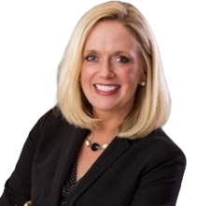
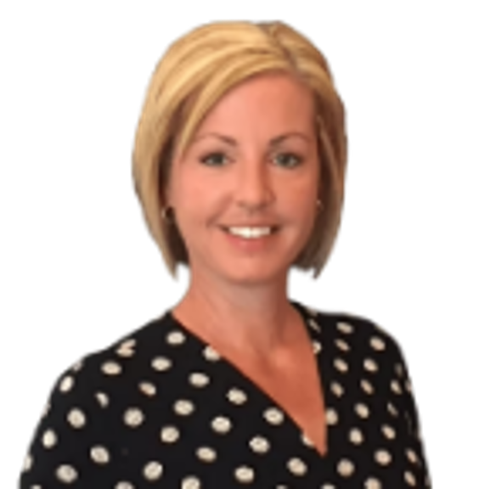
Leadership Team
  Abby Goss
  National Healthcare Vertical Leader
  Abby brings a wealth of experience to AssuredPartners with her impressive 20-year global market carrier background in underwriting and business development. Her extensive experience spans multiple industries with a predominant focus on specialty programs, notably for the senior living and long-term care industry. Abby advocates for our clients by identifying and sourcing new products, providing innovative coverage solutions, and aligning resources with client needs to mitigate risk and improve their bottom line. As our National Healthcare Vertical Leader, Abby collaborates with our offices nationwide, providing industry training and education, guidance, and support to ensure our clients receive an exceptional service experience.
  abby.goss@assuredpartners.com | 706-478-7818
  Kristy James
  Litigation and Clinical Leader
  With over 25 years of experience across various healthcare sectors, Kristy brings unparalleled expertise to her role as leader of our healthcare Litigation and Clinical Consulting Team. Her background spans clinical risk management, litigation, and claims handling, including ten years as a Litigation Manager and six years as a Claims Director. Kristy’s expertise includes managing complex claims litigation for clients in captives and risk retention groups, where she maintained a strong record of favorable trial outcomes. Today, she specializes in handling catastrophic events and media management.
  kristina.james@assuredpartners.com | 614-220-9247

Slide 4
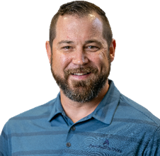
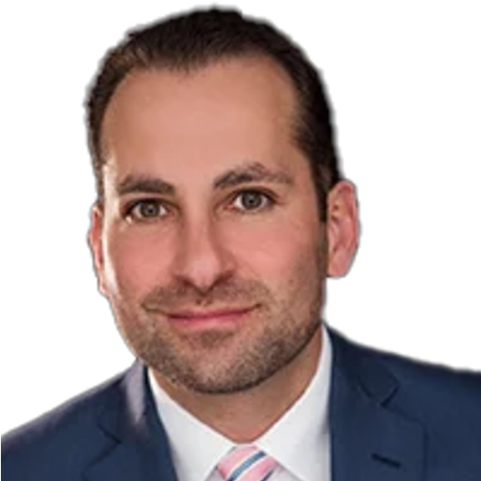
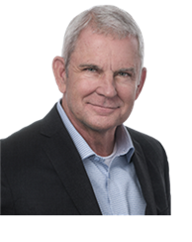
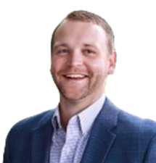
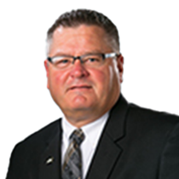
Sales Team
  Mike Randall
  Executive Vice President
  Mike develops and executes strategic direction for vertical structure. As an executive vice president, he plays an active role in deploying vertical resources such as directing the account service, strategic planning, program design, insurance placement, and claims advocacy.
  Jeff Beck
  Executive Vice President
  Jeff works hand-in-hand with clients, carrier partners, and in-house risk management teams to coordinate and deliver customized insurance and risk management solutions to the senior living, developmental disability, and hospice industries. He specializes in employee benefits, workers compensation, and property and casualty insurance.
  Brian Lindahl
  Executive Vice President
  Brian is known for developing and creating insurance solutions essential for the various dynamics of the healthcare industry. He works to support vertical objectives and execution of strategic initiatives by striving to provide the industry’s best. He has built what today are arguably the best clinical, legal and claims handling teams in the business.
  Seth Thompson
  Senior Vice President + Emerging Producer Program Mentor
  Seth’s experience stems from his various leadership roles, demonstrating expertise in investment management, financial analysis, and client relations. His career reflects a strong commitment to delivering strategic financial solutions and fostering client success.
  Lance Horbach
  Vice President + Emerging Producer Program Mentor
  Lance is a seasoned professional with a diverse background in business and politics. He served as a Republican member of the Iowa House of Representatives from 1999 to 2012, representing the 40th district. Lance’s multifaceted experience reflects his dedication to service and business excellence.

