Slide 1
MOMENTUM Country and Global Leadership
Advantages of the Labour Care Guide (LCG) and implementation considerations
Presenter Name, MOMENTUM Country and Global Leadership

Slide 2
Agenda
Chief advantages of the LCG over the WHO modified partograph
Implementation considerations
Training approach

Slide 3

SECTION 01
Advantages
Notes:
Jim

Slide 4
Advantages: Improved respectful care during labour and childbirth
The LCG seeks to improve the experience of care during labour and childbirth in the following ways:
The capacity for women to enact what matters to them is enhanced by using a person-centred care approach.
Providing and documenting non-clinical intrapartum practices (i.e. labour companionship, pain relief, maternal position, oral fluid intake) should ensure women’s comfort and well-being during labour and childbirth and thus their experience of care and improved outcomes.
The inclusion of shared decision-making, whether findings are normal or not, should ensure that 1) women and their companions’ informational needs are met, thus reducing uncertainty and fear; and 2) women and their companions are involved in decisions about care, thus empowering women and helping them maintain a sense of control.
Improved labour support and care leads to improved outcomes

Slide 5
Advantages
Timelier, evidence-based interventions: Reference threshold values for labour observations that define normal, expected ranges for the different parameters, assist providers to:
  Confidently NOT provide interventions if all findings are normal
  Quickly identify if there is a problem and intervene appropriately

Slide 6
Advantages
More accurate assessment of fetal well-being by including decelerations
More accurate assessment of labour progress by:
  Using evidence-based threshold values for cervical dilatation rather than a rate of 1 cm/hour
  Including fetal position to assist with identification of possible cause of slow progress
  Including assessment of caput which can help identify CPD/obstruction

Slide 7
Advantages
Documentation of care during the second stage
Greater accountability - Providers using the LCG are required to
  signal or highlight any observation that is inconsistent with good quality care, well-being, or normal labour progress;
  write the plan of care developed with the woman and her companion; and
  initial the column with assessment findings and the plan of care.
Notes:
Initialling the document is important for two reasons: to create accountability and to tag certain actions or data records with the indexical information of who did or observed what and when that action was taken/when that observation was made. When providers feel accountable they are likely to exert greater effort resulting in performance enhancements and outcomes.

Slide 8
SECTION 02
Implementation considerations
Notes:
Jim

Slide 9
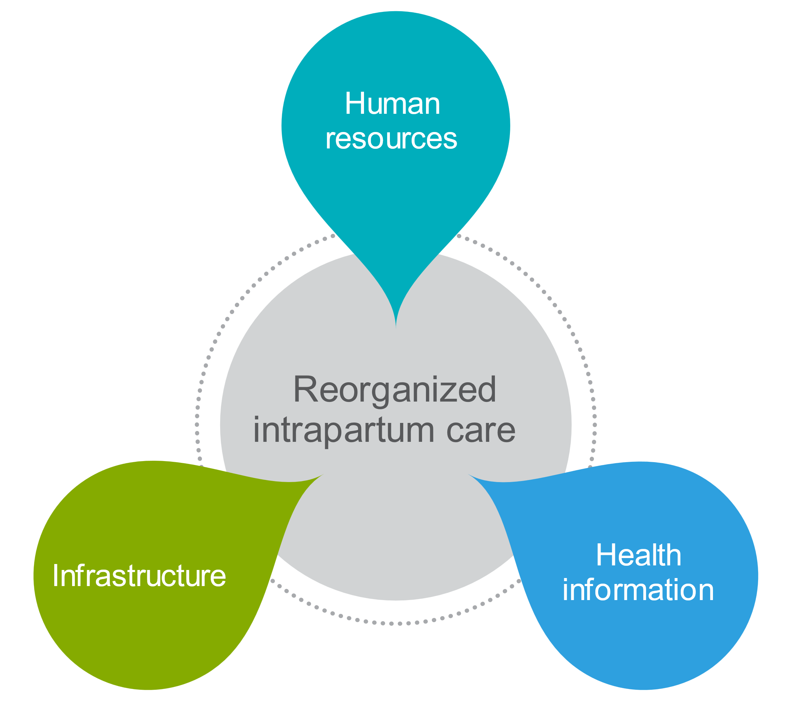
Anticipated impact of introduction of the LCG on organization of care
Source: WHO intrapartum care guideline slide deck

Slide 10
Successful, sustained implementation will require:
Adequate human resources with the necessary expertise and skills to:
  Correctly assess women and babies for all parameters included in the LCG;
  Correctly complete the LCG, interpret findings on the LCG, share decision-making with women and their companions, and develop an appropriate plan of care;
  Coach and mentor providers newly trained to use the LCG and provide structured, constructive feedback on completed LCGs to help users improve their skills;

Slide 11
Care of the baby – Implementation considerations
Given the recommendations for fetal heart assessment, are all providers able to assess:
  Baseline FHR?
  Decelerations?
If not, what needs to be done to ensure correct implementation of the LCG at the facility level?

Slide 12
Care of the baby – Implementation considerations
Are all providers able to assess:
  Fetal position?
  Caput?
  Moulding?
If not, what needs to be done to ensure correct implementation of the LCG at the facility level?

Slide 13
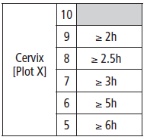
Cervical dilatation
How will you assess labour progress with the new threshold values that have replaced the partograph threshold of 1cm/hour?

Slide 14
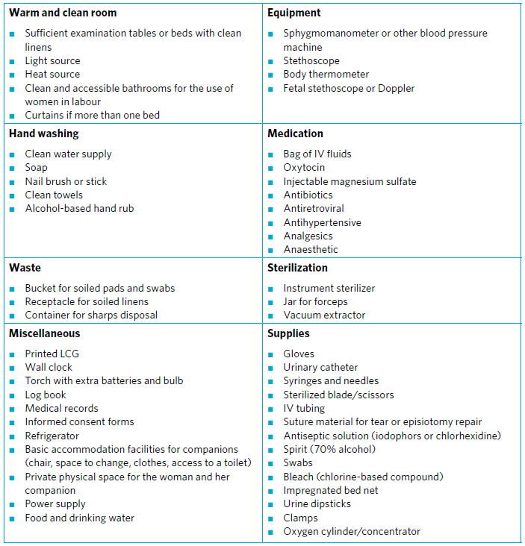
Successful, sustained implementation will require:
Infrastructure updates to support recommended practices, e.g. physical space for labour companions, comfortable waiting rooms for women in early labour.
Adequate equipment, supplies, and medicines to support implementation of the recommendations.

Slide 15
Supportive care – Implementation considerations
Do facilities have adequate private space to accommodate:
  A companion of the woman’s choice?
  Upright positions in labour and birth?
  Mobility in labour?
If not, what needs to be done to ensure correct implementation of the LCG at the facility level?

Slide 16
Equipment, medications, and supplies – Implementation considerations
Are the following available in adequate numbers to correctly monitor women / babies :
  BP machines and stethoscopes
  Pinard fetoscopes / Dopplers (While Dopplers are not necessary, they do make monitoring FHR easier and possibly more reliable)
  Urine dipsticks to assess protein and acetone
If not, what needs to be done to ensure correct implementation of the LCG at the facility level?

Slide 17
Successful, sustained implementation will require:
Adequate human resources with the necessary expertise and skills to maintain or establish a monitoring system based on the LCG to:
  Monitor use of the WHO LCG (correct use, completeness) and appropriate use of interventions;
  Monitor effects of implementing the WHO LCG (health outcomes, e.g. mortality, intrapartum complications, proportion of women with a labour companion of choice, the caesarean birth rate);
  Monitor women’s experience of care during labour and childbirth.
A health information management system designed to document and monitor recommended practices.

Slide 18

SECTION 03
Proposed training approach
Notes:
Jim

Slide 19
Pre-training activities
National level:
Orientation to the LCG
Validation of the LCG, including alert values
Updating policies, clinical protocols, and standards for intrapartum care to reflect the newly adopted LCG
Agreement on key roles and responsibilities for implementation of the LCG
Agreement on indicators and follow-up / supervision of activities and trained providers
Development of an implementation strategy
Provincial and district levels:
Orientation of district and provincial authorities / supervisors to the LCG
Development of an implementation strategy (training, supervision, and monitoring plans) at the district and provincial levels

Slide 20
Pre-training activities
Facility level:
Orientation of management and maternity providers to the LCG and to implementation activities
Advocacy efforts to ensure buy-in by management and maternity providers
Assurance that an appropriate enabling environment is in place for providers to use the LCG, e.g.:
  Adequate human resources with the necessary expertise and skills.
  Infrastructure updates to support recommended practices, e.g. physical space for labour companions, comfortable waiting rooms for women in early labour.
  Adequate equipment, supplies, and medicines to support implementing the recommendations.
  Adequate human resources to document and monitor implementation of the LCG.

Slide 21
Pre-training activities
Provider level:
Assessment of providers’ capacity to assess ALL parameters on the LCG and development of a plan to update providers’ skills as needed.
  If possible, arrange for all maternity providers to complete a course on “Essential Care during Labour and Childbirth” OR
  Organize activities to reinforce competency for identified skills prior to training on the LCG OR
  Organize post-training activities to reinforce skill gaps.

Slide 22
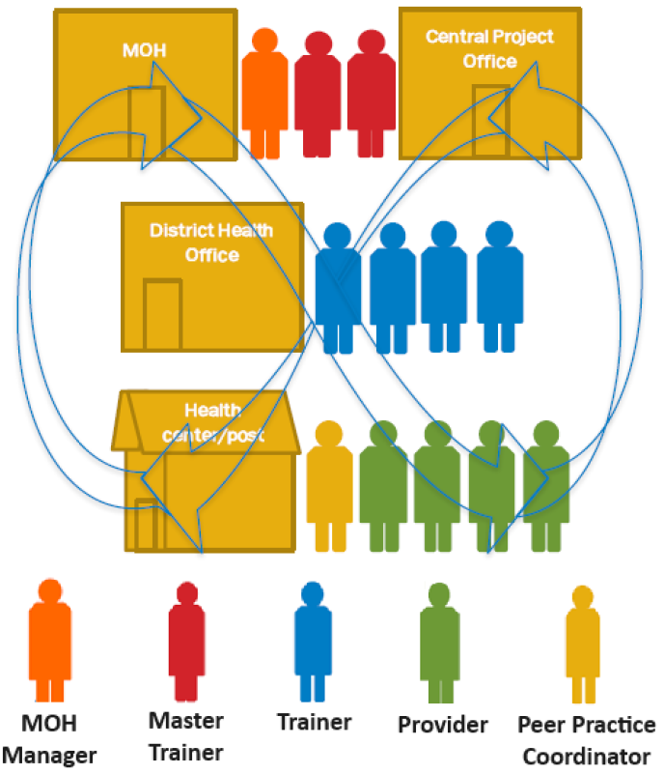
Key roles and responsibilities
Advocacy to address challenges (e.g., lack of equipment/supplies, inability to accommodate companions, staffing)
Procurement (LCGs, training materials)
Training: Master Trainer workshops, facility-based training of providers and orientation of facility-based PPCs —including documentation and coordination with national training institutions for certification
District rollout: facility visits; follow-up for PPCs, supportive supervision (integration of LCG implementation into supervisory tools and visits)
M&E: Data from existing systems, additional data collection; data aggregation, entry and analysis, data use for decision-making
QI: Existing QI systems, additional QI data collection for LCGs; data aggregation, entry and analysis, data use for decision-making

Slide 23
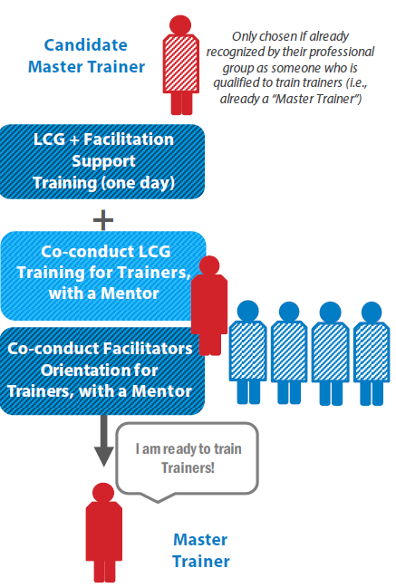
Training of Master Trainers
Candidate Master Trainers should be experienced trainers with recent clinical experience monitoring and caring for women in labor.
Candidate Master Trainers participate in LCG training activity followed by 1-day facilitation training.
After facilitation training, candidates co-conduct their first LCG training for Trainers while being mentored.
Then they are recognized as LCG Master Trainers.

Slide 24
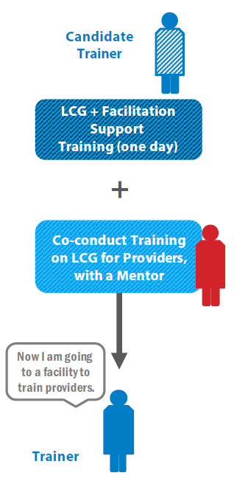
Training of Trainers
Candidate Trainers should have recent clinical experience monitoring and caring for women in labor and be respected clinicians.
Candidate Trainers participate in LCG training activity, followed by 1-day facilitation training.
After facilitation training, candidates co-conduct their first LCG training for providers and orientation of peer practice coordinators while being mentored.
Then they are recognized as LCG Trainers.

Slide 25
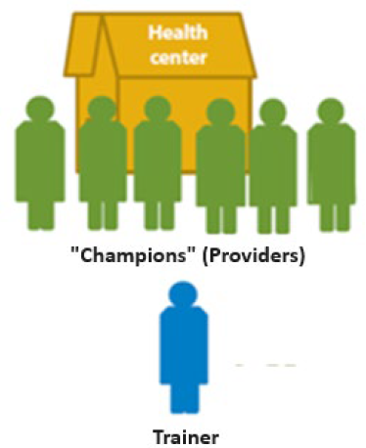
Training of providers
Trainers conduct on-site training for facility-based providers.
Each trainer is assigned to a facility. S/he visits each facility for on-site learning. The trainer brings the learning materials.
Each training should have a ratio of one trainer to six providers.
Providers (nurses, midwives, doctors), support staff, and supervisors or in-charges are trained as a team so roles are clear.
WhatsApp groups are developed between Master Trainers and Trainers to provide ongoing support.
Master Trainers review training reports to identify issues and work with Trainers to resolve them.

Slide 26

Orientation of peer practice coordinators (PPCs)
Trainers facilitate selection of PPCs (2/health center, 3/hospital) with the facility in-charge.
PPCs participate in a 1/2-day orientation to facilitate implementation of the LCG.
The maternity in-charge facilitates scheduling LDHF sessions and providers’ participation.
The Trainer assigned to the facility will mentor and support the PPCs and review the LDHF logbook to ensure sessions are taking place.
WhatsApp groups are developed between Trainers and PPCs to provide ongoing support.

Slide 27
Post-training practice at a facility
Notes:
Following the training, PPCs organize and facilitate weekly team reviews of completed LCGs and group problem-solving to improve correct completion, interpretation, and taking appropriate action based on findings on the LCG.
One of the PPCs runs weekly reviews of completed LCGs, individually or in groups with all providers. In addition, Trainers and/or PPCs may work individually with providers who have difficulty assessing decelerations, caput, moulding, or fetal position.
Trainers and District Supervisors provide ongoing support to implementation, ongoing QI activities, and monitoring & evaluation of project activities.
Trainers will work with facility management to develop non-financial motivational and incentive options, e.g. friendly competition between facilities, congratulatory/motivational text messages to PPCs, letters posted in the facility with congratulatory/motivational messages (e.g. “2 out of 6 weekly review sessions were completed – keep up the good work!”).

Slide 28
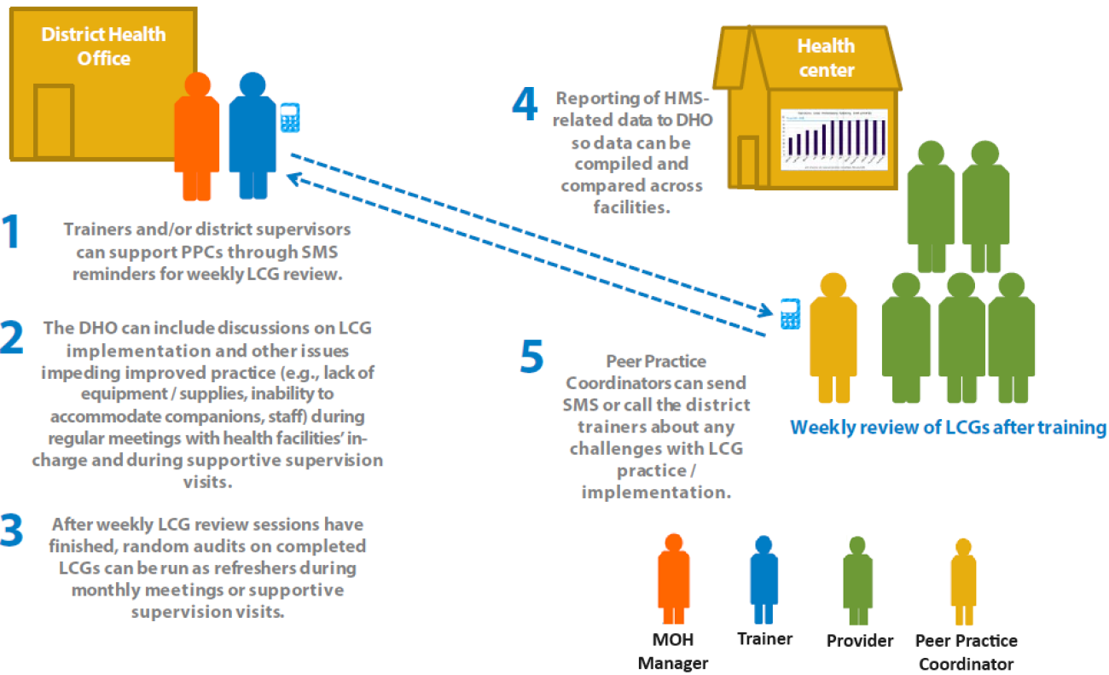
Post-training support

Slide 29

SECTION 04
Next steps

Slide 30
Next steps

Slide 31

THANK YOU
@USAID_MOMENTUM
This presentation is made possible by the generous support of the American people through the U.S. Agency for International Development (USAID) under the terms of the Cooperative Agreement #7200AA20CA00002, led by Jhpiego and partners. The contents are the responsibility of MOMENTUM Country and Global Leadership and do not necessarily reflect the views of USAID or the United States Government.
@USAIDMOMENTUM
USAID MOMENTUM

